Slide 1
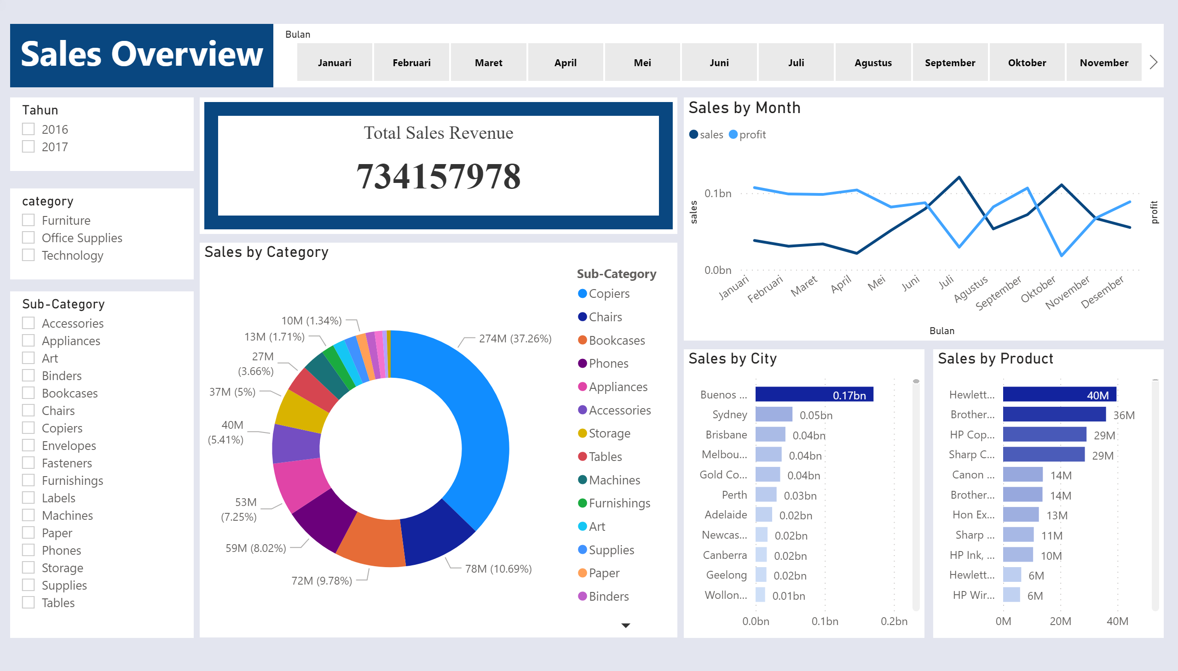
SO by Revenue
Notes:
textbox
No alt text provided.
slicer
No alt text provided.
Sales by Month
No alt text provided.
slicer
No alt text provided.
slicer
No alt text provided.
slicer
No alt text provided.
Sales by City
No alt text provided.
Sales by Category
No alt text provided.
Sales by Product
No alt text provided.
BBED0A4D4D8D44CE93CF2DAFADEE466C
No alt text provided.

Slide 2
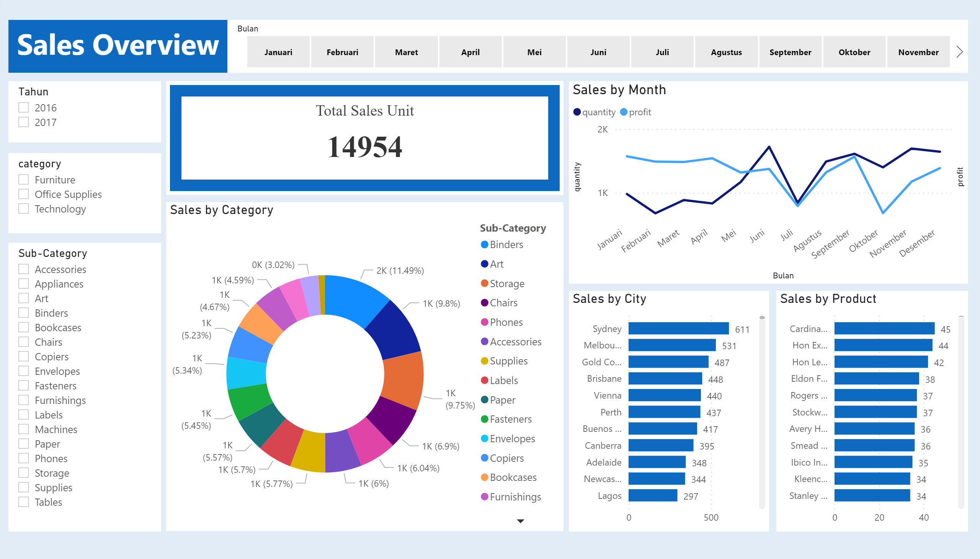
SO by Unit
Notes:
textbox
No alt text provided.
slicer
No alt text provided.
Sales by Month
No alt text provided.
slicer
No alt text provided.
slicer
No alt text provided.
slicer
No alt text provided.
Sales by City
No alt text provided.
Sales by Category
No alt text provided.
Sales by Product
No alt text provided.
BBED0A4D4D8D44CE93CF2DAFADEE466C
No alt text provided.

Slide 3
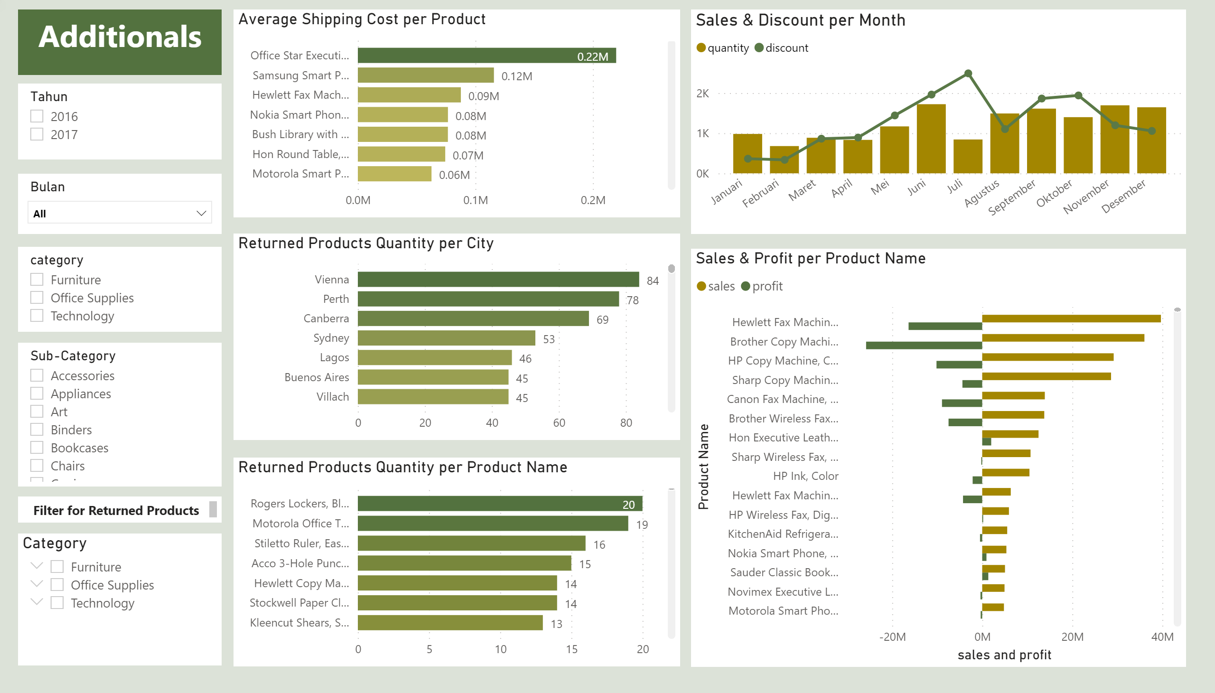
Additionals
Notes:
textbox
No alt text provided.
Sales & Discount per Month
No alt text provided.
slicer
No alt text provided.
Month
No alt text provided.
Average Shipping Cost per Product
No alt text provided.
Returned Products Quantity per Product Name
No alt text provided.
Returned Products Quantity per City
No alt text provided.
Sales & Profit per Product Name
No alt text provided.
slicer
No alt text provided.
textbox
No alt text provided.
Category
No alt text provided.
slicer
No alt text provided.

